Slide 1
HR ANALYTICS (P671)
DATA ANALYST
Name : Sachin B N
Email ID : sachinbnsachin73@gmail.com

Slide 2
SUMMARY
Analyze how monthly income influences employee attrition. This data highlights the importance of competitive salary structures and compensation reviews to improve retention.
Explore the relationship between job roles and the perceived work-life balance.
Analyze the attrition rate across various departments, specialized technical roles tend to provide career stability and opportunities for advancement.
Evaluate the average number of years employees stay in each department before leaving.
Investigate the correlation between time since last promotion and attrition rate.

Slide 3
KPI LIST
Average Attrition rate for all Departments.
Average Hourly rate of Male Research Scientist.
Attrition rate Vs Monthly income stats.
Average working years for each Department.
Job Role Vs Work life balance.
Attrition rate Vs Year since last promotion relation.
Count of employees respective to fields.

Slide 4
Data Analytics Techniques Used:
Correlation Analysis: To identify relationships between variables like income, job role, and attrition.
Segmentation: Grouping employees by department, income level, or job role to understand unique trends.
Survival Analysis: To estimate the probability of an employee staying in the company based on factors like years since promotion or department.
Trend Analysis: Tracking attrition trends over time to understand how they relate to organizational changes.

Slide 5
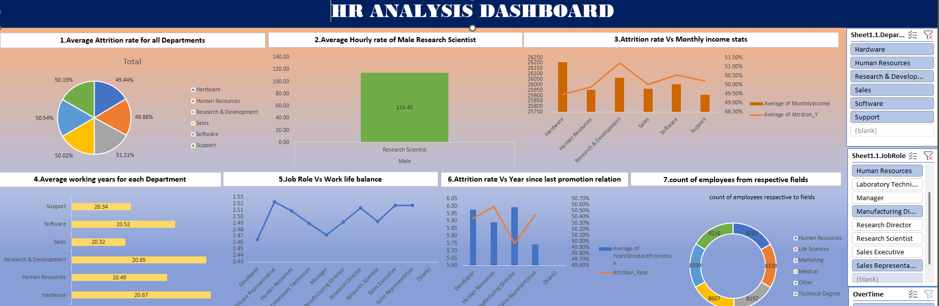
EXCEL DASHBOARD

Slide 6
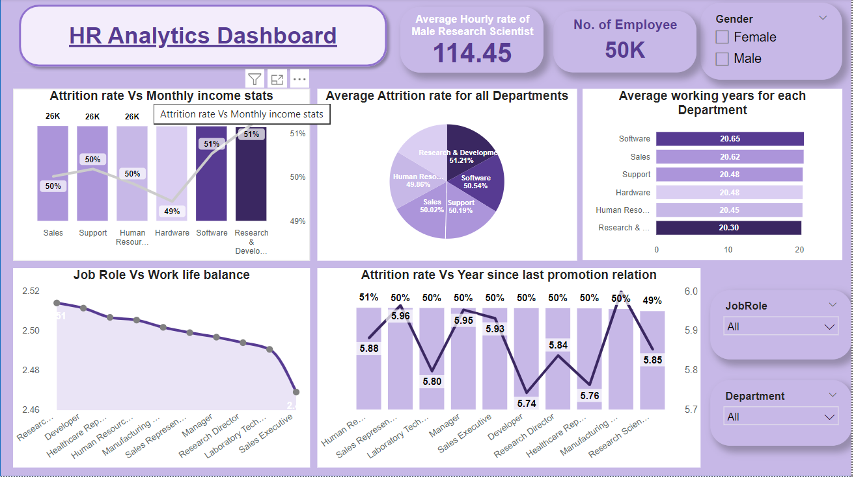
POWER BI DASHBOARD

Slide 7
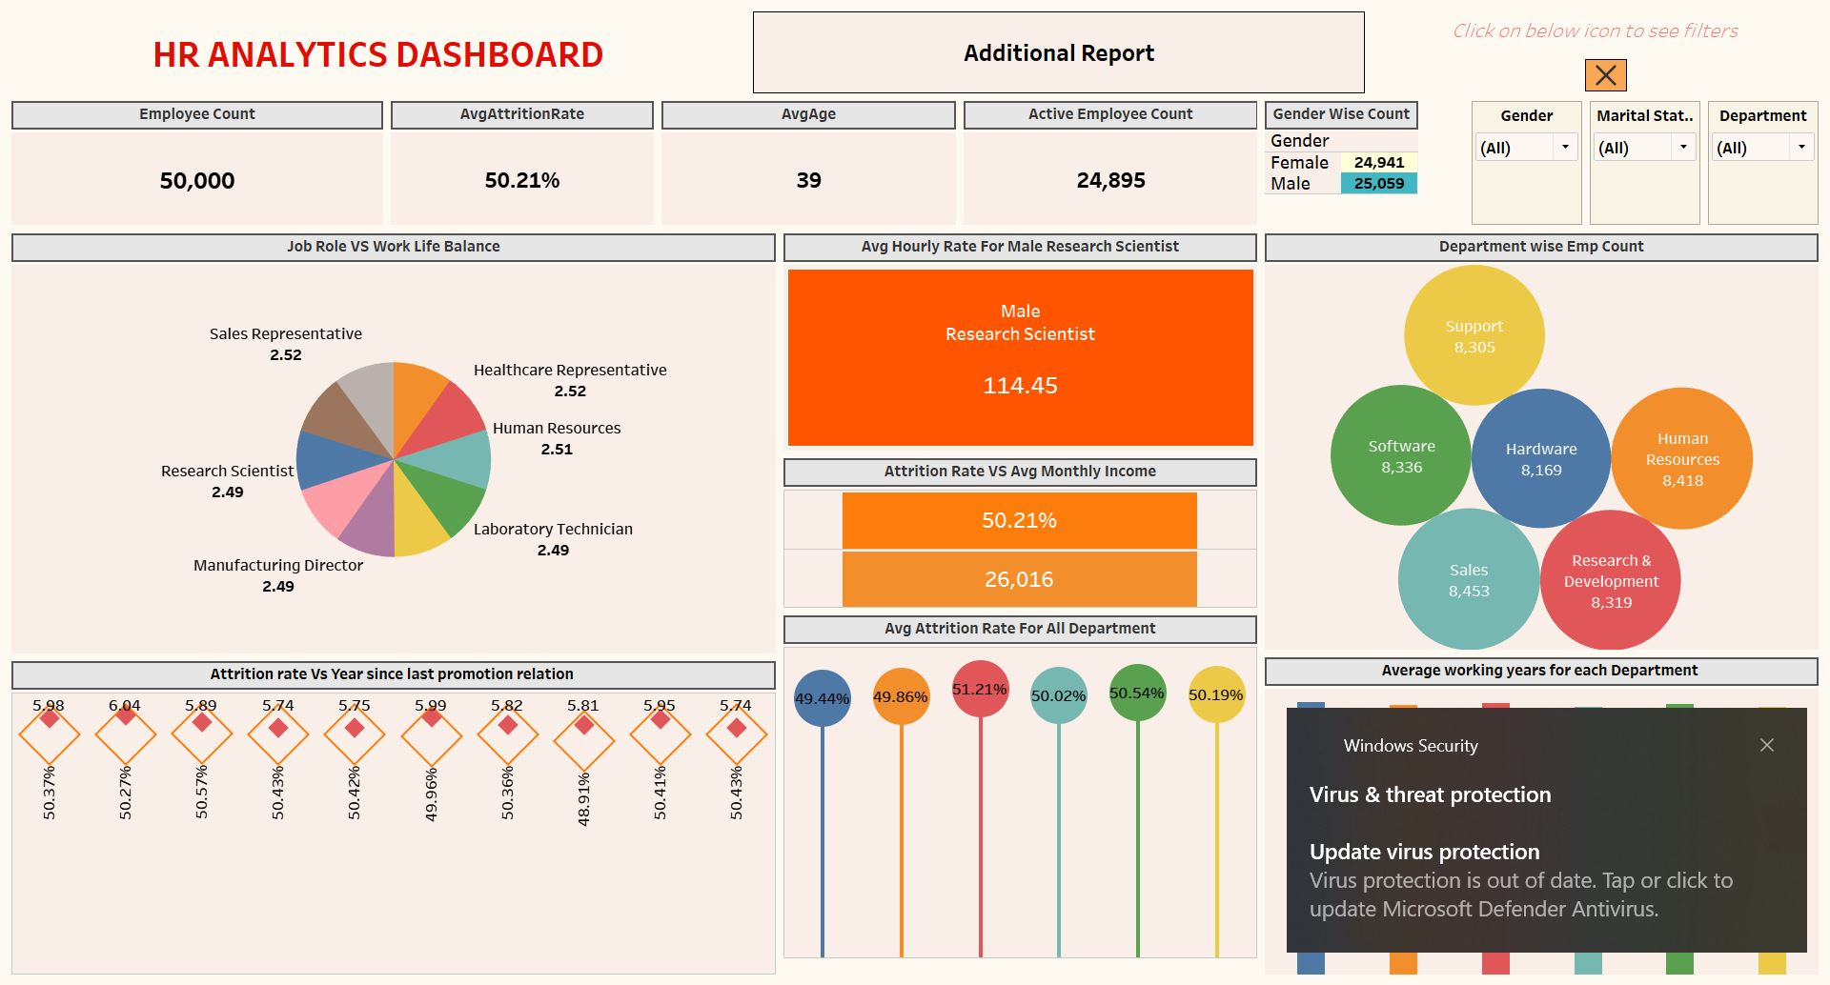
Tableau DASHBOARD

Slide 8
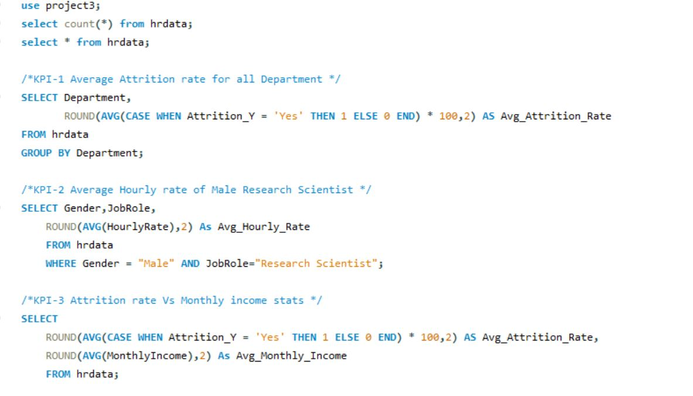
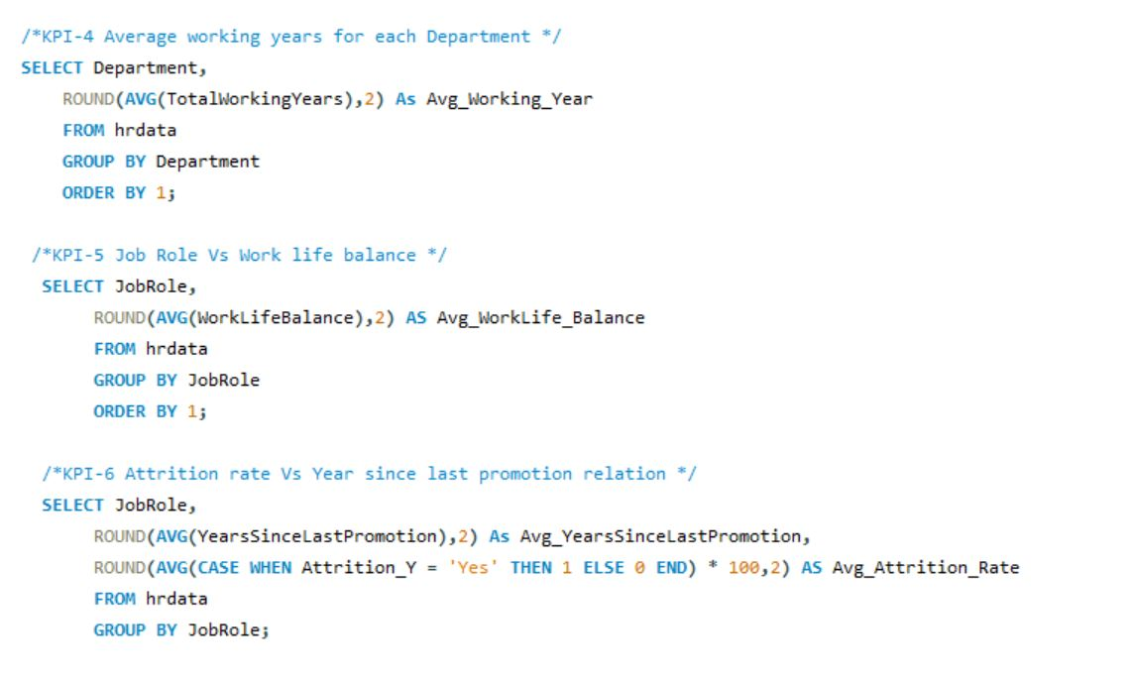
sql queries

Slide 9
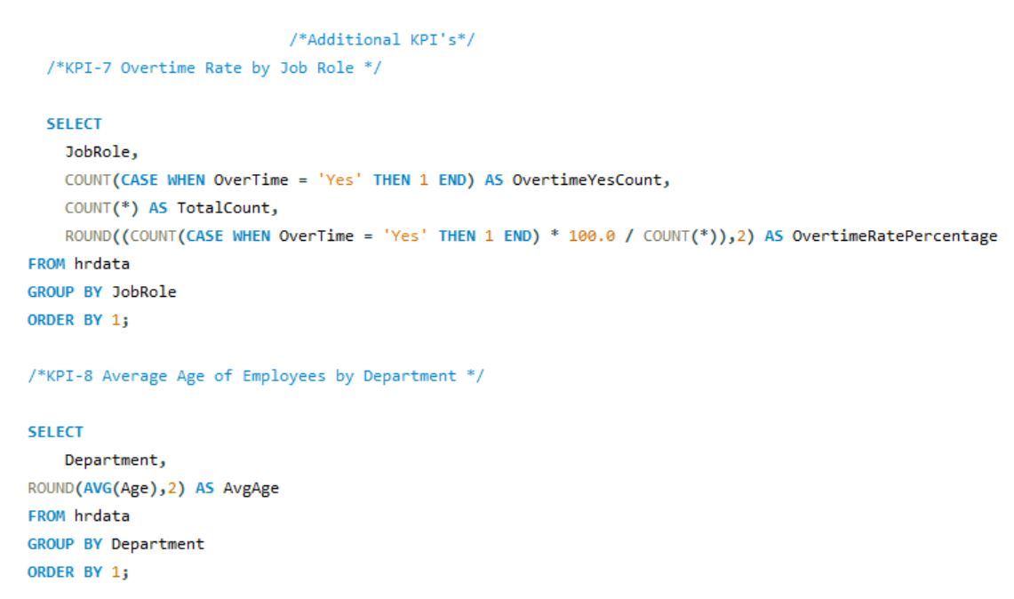

Slide 10
KEY TAKEAWAYS
Organizations should review salary scales and ensure competitive compensation, particularly in roles with high attrition.
Implement work-life balance initiatives (e.g., flexible work hours, remote work options) to improve employee satisfaction and reduce attrition in high-demand roles.
Tailor retention strategies by department. Should implement performance support and stress management initiatives, while IT and Engineering departments may need career growth and training opportunities.
For departments with high turnover, focus on employee engagement and career progression. For departments with lower tenure, investigate whether there are growth opportunities or internal mobility options to retain employees.
Ensure that there are clear promotion paths and regular career development reviews. Employees who feel they can grow within the company are more likely to stay longer and perform better.
This analytical approach allows organizations to make informed decisions, fostering a more stable and engaged workforce.

Slide 11
THANK YOU
END OF SLIDES

